Slide 1
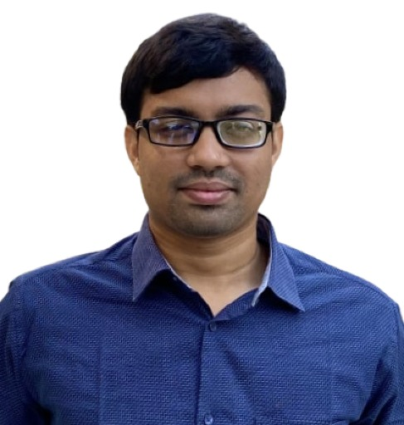



Md. Zahim Hassan
Address:
KUET, Khulna
Phone:
+88 01736 393334
Email:
hassan1707007@stud.kuet.ac.bd
Education:
2023
B.Sc. In Computer Science and Engineering
Khulna University of Engineering & Technology(KUET)
Khulna-9203, Bangladesh
2017
Higher Secondary School Certificate
Armed Police Battalion Public School & College
Nishindara-5800, Bangladesh
Skills:
Language
Programming Language: Python, C++
Web-based: HTML, CSS, JavaScript, PHP
DBMS: MySQL
Framework/Tools
Tensorflow, Keras, Scikit-learn, OpenCV, Pandas, Codeblocks, Visual Studio Code, Django, Pycharm, Oracle DBMS, Jupyter Notebook
Domain
Machine Learning, Deep Learning, Computer Vision, Web Development, OOP, Android, Database Management
Other
Public speaking, Leadership, Team work, Team management, Punctuality, Assertiveness, Productive communication

Slide 2
Projects
Automatic Bangladeshi License Plate Recognizer System
An automatic LPR system using deep neural networks for Bangladeshi vehicles | System Development Project
iGhotok
An iOS application for finding desired male/female candidate for marriage | Mobile Computing Project
LifeSource
A website for finding and requesting blood donors immediately | Web Development Project
Publications
Syed Nahin Hossain, Md Zahim Hassan and Md. Masum Al Masba “Automatic License Plate Recognition System For Bangladeshi Vehicles Using Deep Neural Network”, in BIM 2021, Cox’s Bazar, Bangladesh.
Achievements
Best Paper Award in “Machine Learning” category for the paper “Automatic License Plate Recognition System For Bangladeshi Vehicles Using Deep Neural Network”, at BIM 2021, Cox’s Bazar, Bangladesh.
Merit Scholarship from Rajshahi Education Board, Bangladesh (HSC).
Obtained 1st position in regional round Bangladesh Chemistry Olympiad in 2017.
Co-curricular Activities
General Secretary (2022-Present) - Bit2Byte (Software Research & Development Community of KUET)
Vice President (2022- Present) - Hardware Acceleration Club of KUET
Volunteered in “BITFEST 2019”
Volunteered in “Intra-KUET Math Fest 2019”
Solved many Problems in various Online Programming Platforms.

